Slide 1
DSI Project 1: Group 1
An analysis of SAT/ACT Participation and Scores (2017/18)
Lim Yu Zheng
Yeo Jia Chi
Shauna Loh
Vincent Lee

Slide 2
Problem statement:
To improve student participation and expand the use of SAT in US college admissions, which state should the College Board be focusing its advocacy efforts to maximize SAT enrollment?

Slide 3
SAT/ACT data sets used
Exploratory Data Analysis (EDA)
Key findings
Recommendations
Presentation Outline

Slide 4
List of data sets used (Internal) - ACT 2017/2018 - SAT 2017/2018
List of data sets used (External) - State student pop., No. who took SAT 2017/2018 - High-school student projections (2010-30)
Data Sets Used

Slide 5
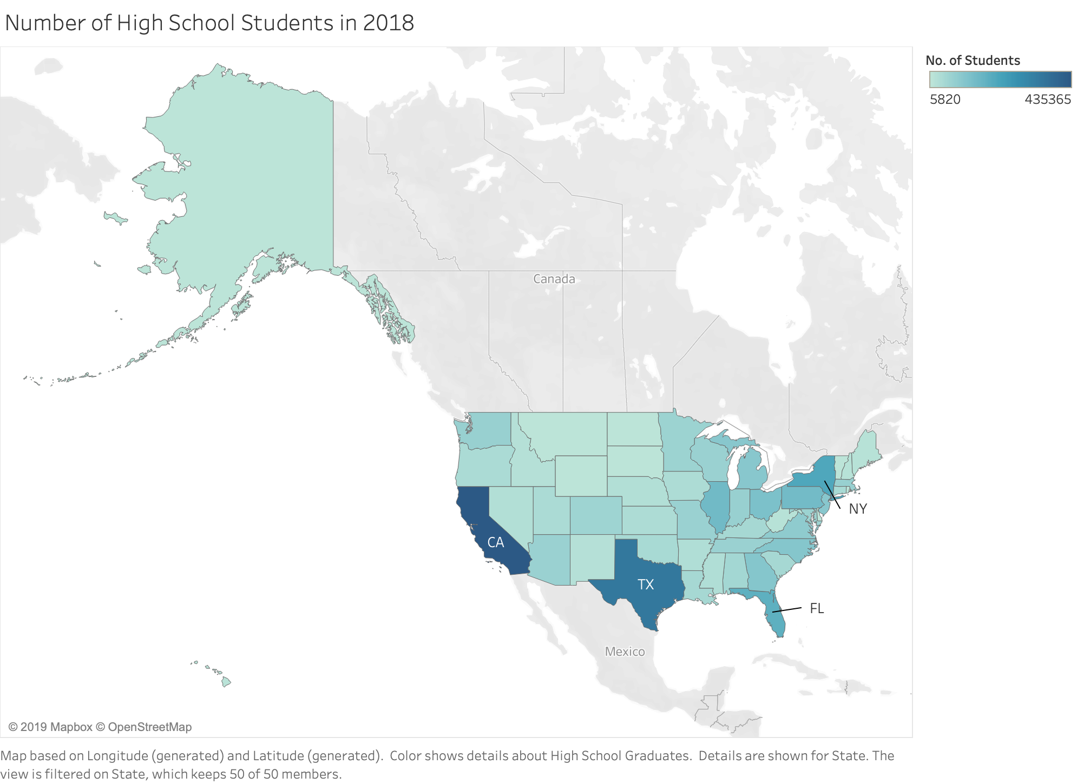
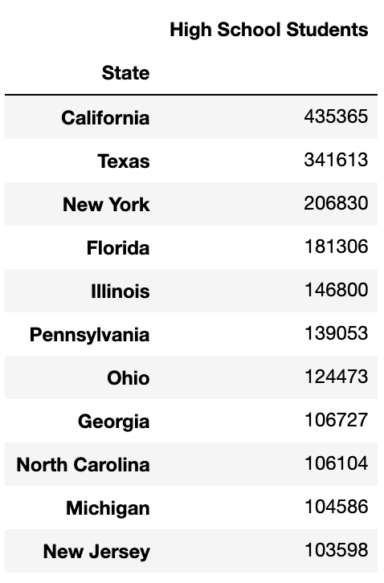
Understanding the Market
Top 10 states with the most high-school students
High-school student distribution across the US
2018 College Board SAT Report (Total Group)

Slide 6
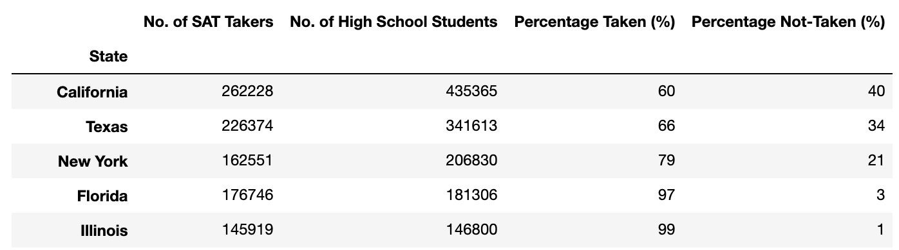
EDA: Untapped Student Potential (USP)
Formula:
USP = S x p
USP = Untapped Student Potential
S = High School Student Population Size
p = Percentage of High School Students who have not taken the SAT
SAT 2018 Participation Data
S
p
USP
Notes:
JC: Break this into seperate slides? One for 2017 and another for 2018?

Slide 7
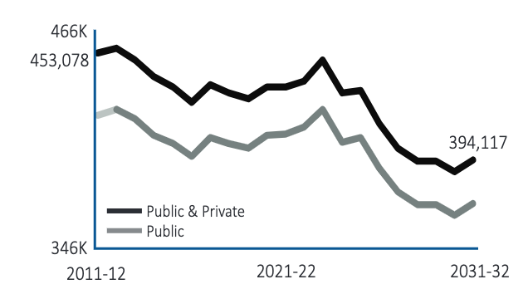
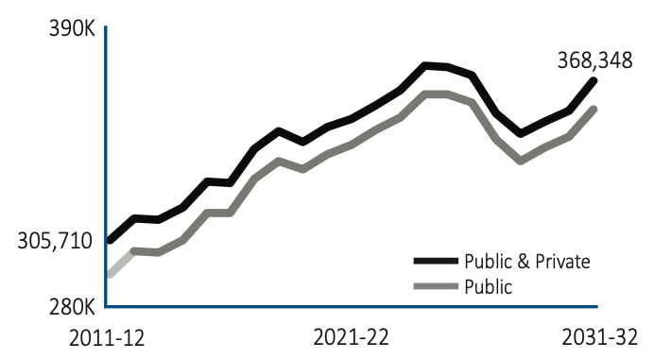
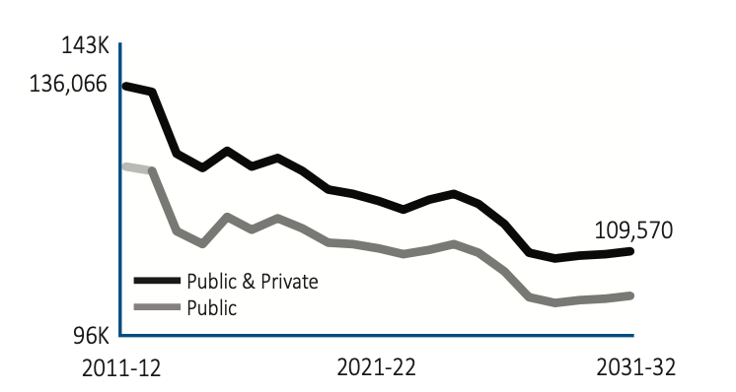
EDA: High-school student growth projections 2020-2030
California
Texas
Ohio
Observations:
Number of high-school students from California and Texas is projected to remain high for the coming decade.
Bramberger and Michelau (2016)

Slide 8
EDA: California, Texas, Ohio
Selected due to a high student population with sustained potential for SAT expansion within these states

Slide 9
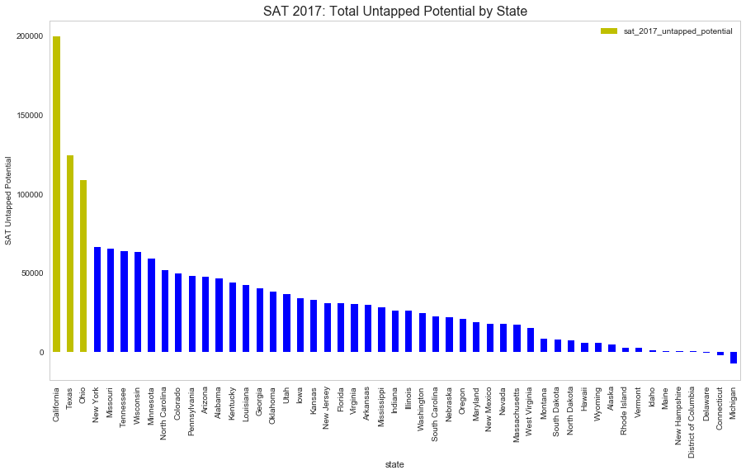
EDA: Measuring untapped student potential (2017)
California: 199,165
Formula:
USP = S x p
USP = Untapped Student Potential
S = High School Student Population Size
p = Percentage of High School Students who have not taken the SAT
Texas: 124,042
Ohio: 108,530

Slide 10

EDA: Measuring untapped student potential (2018)
California: 173,137
Formula:
USP = S x p
USP = Untapped Student Potential
S = High School Student Population Size
p = Percentage of High School Students who have not taken the SAT
Texas: 115,239
Ohio: 101,481

Slide 11
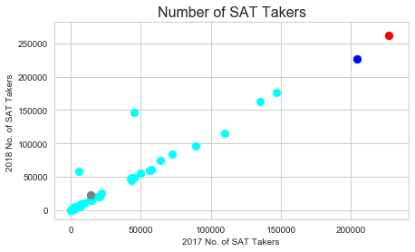
EDA: Correlation of SAT demand from 2017-18
CA
TX
Observations:
A strong positive correlation between number of SAT takers in 2017 and 2018.
California: Highest demand (in terms of absolute numbers) for the SAT.
OH
Notes:
JC: Colored dots for California, Texas and Ohio
JC: Breakdown for individual years 2017, 2018

Slide 12
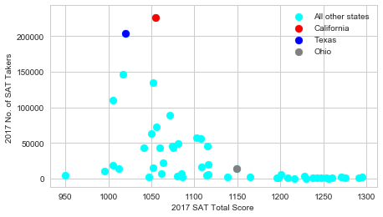
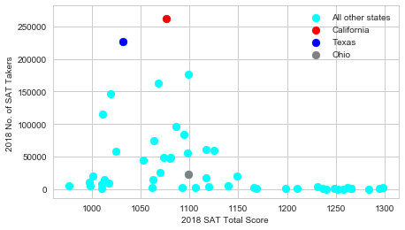
EDA: Corr between SAT scores and # of test-takers for 2017-18
2017
2018
No correlation between the number of SAT takers and their total score for all states, nor California

Slide 13
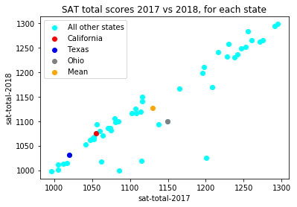
Observations:
SAT 2017
National Avg: 1126
California: 1055
Texas: 1020
Ohio: 1149
SAT 2018
National Avg: 1125
California: 1076
Texas: 1032
Ohio: 1099
Relevance:
California and Texas' SATs scores are lower generally lower than the US National average.
Understanding the reasons behind could help the formulation of possible solutions.
EDA: US state SAT scores across 2017-18
Notes:
JC: Would a boxplot be better?

Slide 14
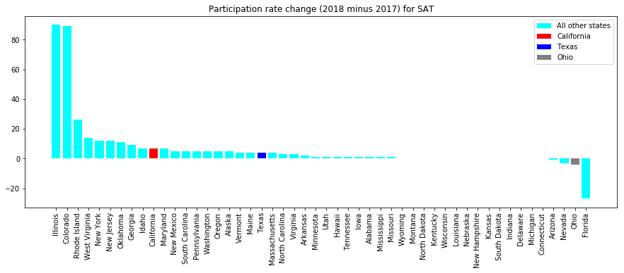
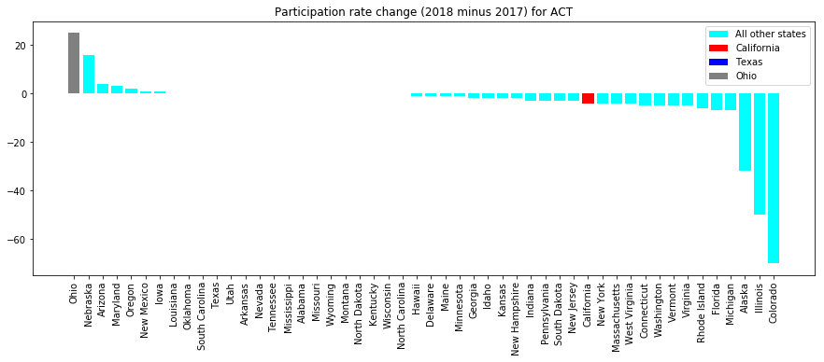
Observations:
SAT: Slight increase in participation rates for California and Texas, but a drop for Ohio.
ACT: Slight drop in participation rates for California, and an increase for Ohio. No change observed in Texas.
Relevance:
Investigating the causes behind these changes could aid policy formulation efforts.
EDA: SAT/ACT Participation Changes from 2017-18
SAT
ACT

Slide 15
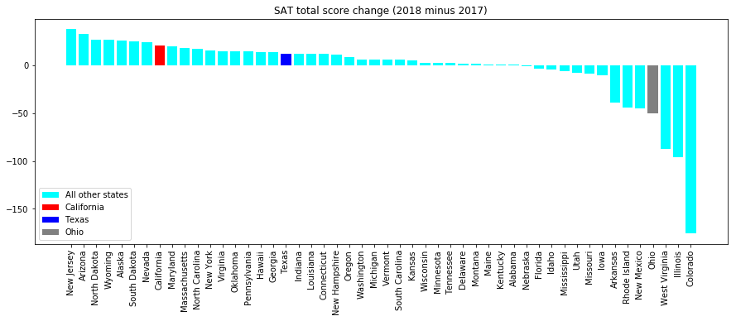
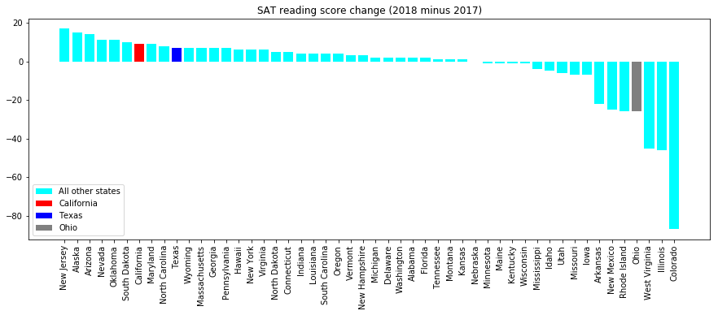
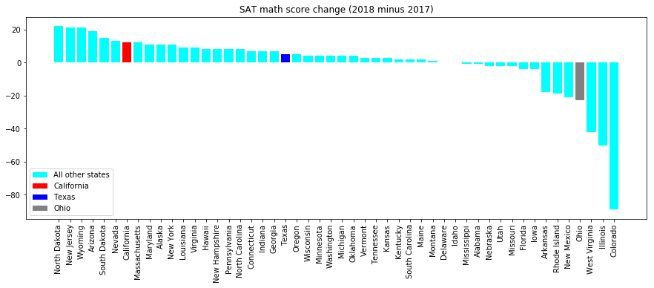
Observations:
Good increase in total, reading, math for California and then Texas.
But sizeable drops for Ohio.
Relevance:
Are there areas in state’s education policies which we can target to further improve scores?
EDA: SAT Score changes from 2017-18
SAT Total
SAT EBRW
SAT Math

Slide 16
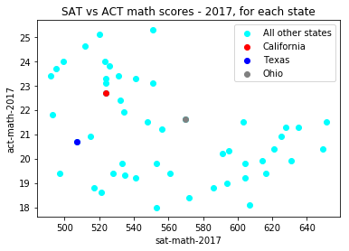
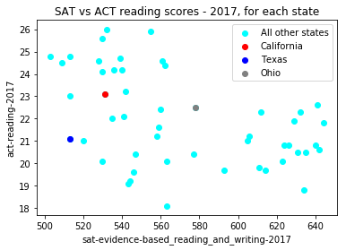
Observations:
No correlation between ACT & SAT scores
For California and Texas, their low SAT total scores are clearly due to their poor math AND reading/verbal scores, relative to other states.
Relevance:
Looks like if we want to raise their participation rates, we might have to first help boost their math and reading/verbal scores, and hence their confidence in taking the SAT tests, to raise participation rates
EDA: SAT vs ACT scores across US states in 2017
Notes:
JC: If we can find why Math and VB scores are low, it can help efforts to formulate promotion policies

Slide 17
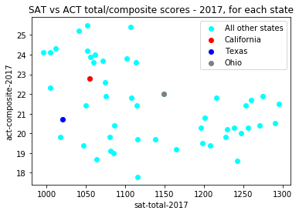
For California and Texas, they tend to do relatively poorly in SATs, vs other states.
In fact California does better in ACTs than in SATs.
Looks like we have much work to do, to poach students over from ACTs to SATs
EDA: SAT vs ACT total/composite scores

Slide 18
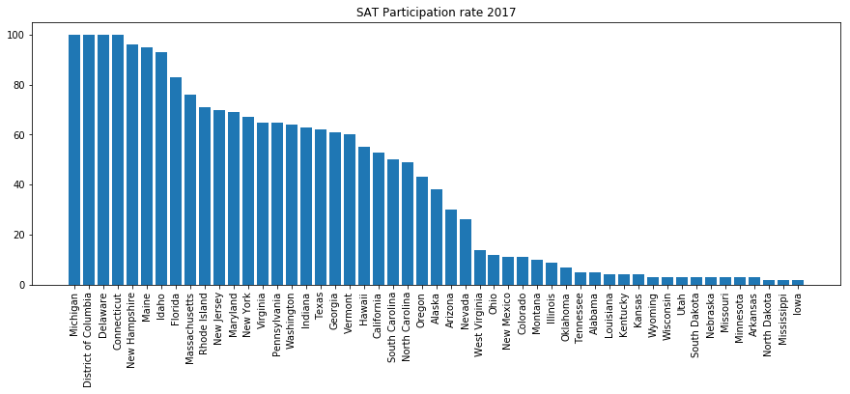
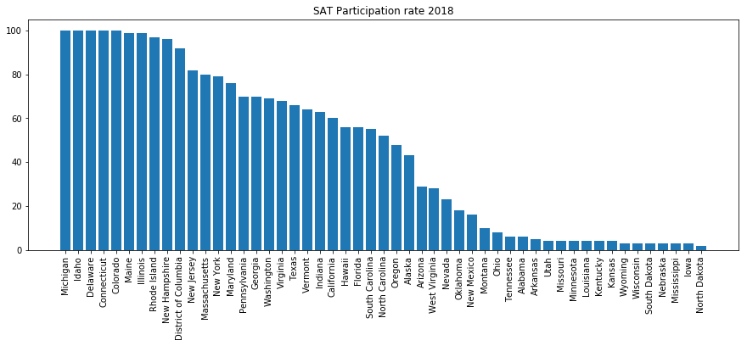
Observations:
Michigan, Delaware, Connecticut at 100%
Are they doing something right there?
EDA: Highest SAT participation rates in 2017-18
Notes:
These states have high participation due to their mandatory SAT testing

Slide 19

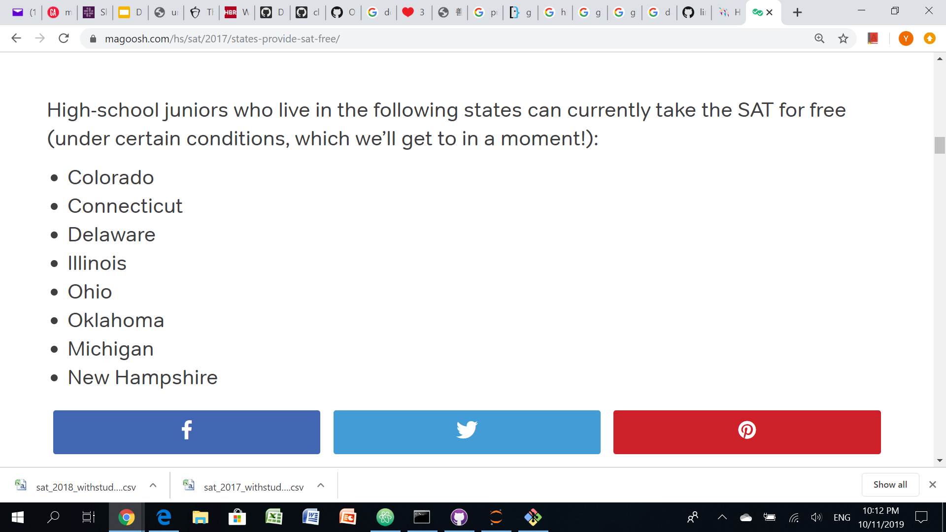
Illinois, Colorado.
Are they doing something right there?
Indeed!
EDA: Highest increase in SAT participation rates from 2017 to 18
Relevance:
Understanding the rationale behind the implementation of free or mandatory testing could help us in our solution formation.
Free SAT testing
https://magoosh.com/hs/sat/2017/states-provide-sat-free/
Notes:
These states have high participation due to their mandatory SAT testing

Slide 20
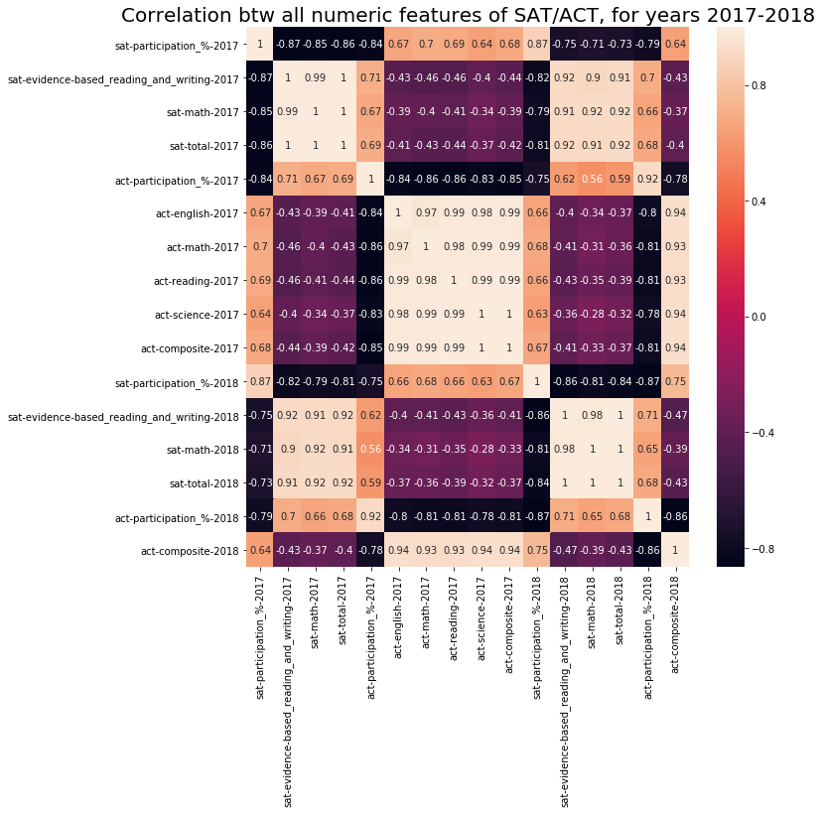
SAT Participation rates tend to be inversely correlated to SAT Total scores (from sns.heatmap, 2017: -0.84, 2018: -0.87). Likewise for ACT (Green)
Doing well in SAT math, doesn't correlate to doing well in ACT math (see 2017's -0.4 corr score) (Orange)
Likewise, doing well in SAT reading/verbal, doesn't correlate to doing well in ACT english or reading (see 2017's -0.43 and -0.46 corr scores) (Cyan)
EDA: Correlations

Slide 21
It is proposed that the College Board focus SAT advocacy efforts for the state of California.
Based on current trends, and all things constant, the USP for California is expected to remain high.
SAT scores from California are generally lower than the US national mean.
A large majority of California high-school SAT takers send their SAT scores within California
86% of in state California universities require SAT for admission
Key Takeaways: Target the state of California

Slide 22
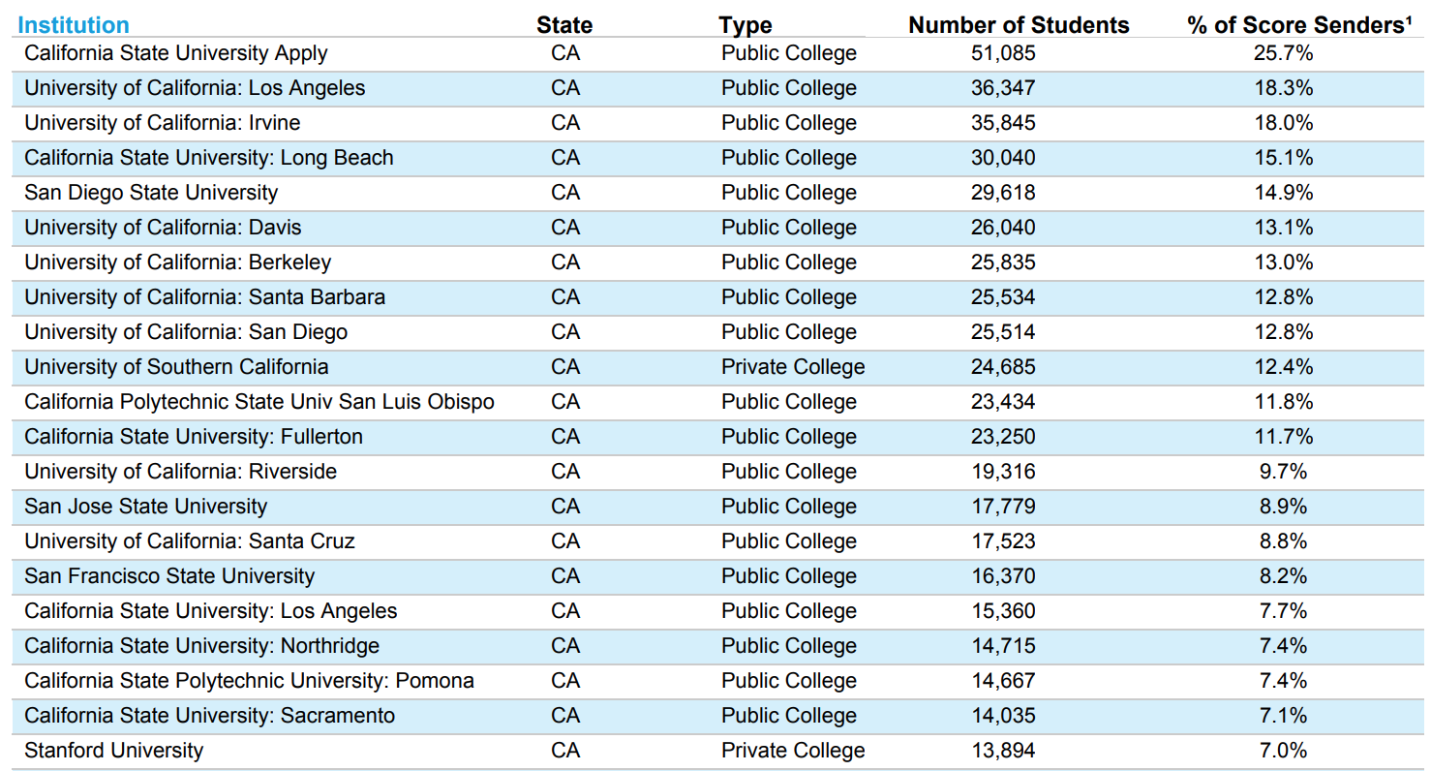
Most students taking the SAT in California submit their results to in-state colleges
2018 College Board SAT Report (California)

Slide 23
Further studies into California state background/policies are necessary to identify the best course of action:
California State Education Policy:
College opportunities and student prep/assistance schemes?
Is there sufficient demand/need to implement mandatory SAT testing?
High-school Students Background:
How receptive are California students towards college education?
How do their family backgrounds affect their career choices?
College Admission Policy:
How do California state colleges rank students applications?
Are there College assistance schemes for underprivileged applicants?
Recommendations

Slide 24
Thank You!
Questions?

